Slide 1
Introduction to Programming
Lecture 07

Slide 2
Programming Languages
Computers can not use human languages, and programming in the binary language of computers is a very difficult, tedious process
Therefore, most programs are written using a programming language and are converted to the binary language used by the computer
Programming languages are divided into five generations.

Slide 3
Generation of Programming Languages
First Generation Languages
Second Generation Languages
Third Generation Languages
Fourth Generation Languages
Fifth Generation Languages

Slide 4
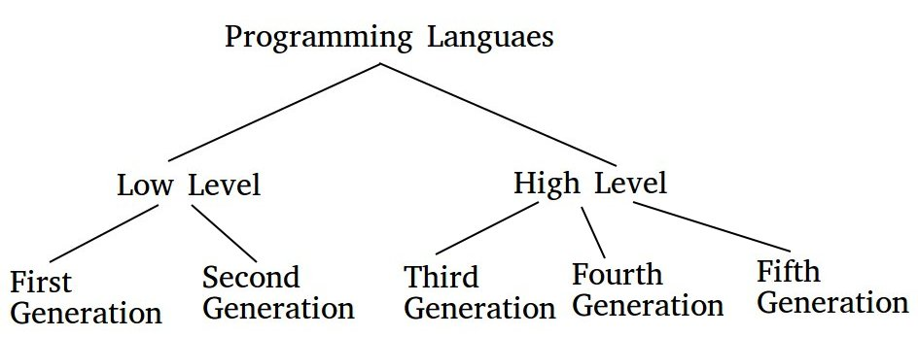
Generations of Programming Languages

Slide 5
Generations of Programming Languages
There are five generation of Programming languages. They are:
First Generation Languages:
These are low-level languages like machine language.
Second Generation Languages: These are low-level assembly languages used in kernels and hardware drives.
Third Generation Languages:
Closer to English but included simple mathematical notation.
Programs written in source code which must be translated into machine language programs called object code. The translation of source code to object code is accomplished by a machine language system program called a compiler.
These are high-level languages like C, C++, Java, Visual Basic and JavaScript.

Slide 6
Generations of Programming Languages
Fourth Generation Languages:
A high level language (4GL) that requires fewer instructions to accomplish a task than a third generation language.
These are languages that consist of statements that are similar to statements in the human language. These are used mainly in database programming and scripting. Example of these languages include Perl, Python, Ruby, SQL, Matlab (Matrix Laboratory).
Fifth Generation Languages:
These are the programming languages that have visual tools to develop a program. Examples of fifth generation language include Mercury, OPS5, and Prolog.

Slide 7
Machine Language
Primitive instructions built into every computer
Very efficient code but very difficult to write – one misplaced 1 or 0 will cause the program to fail.
Operation code – such as addition or subtraction.
Operands – that identify the data to be processed.
Machine language is machine dependent as it is the only language the computer can understand.
The instructions are in the form of binary code 1’s and 0’s
Any other types of languages must be translated down to this level
Example of code: 1110100010101 111010101110 10111010110100 10100011110111

Slide 8
Assembly Languages
Symbolic operation codes replaced binary operation codes.
Assembly language programs needed to be “assembled” for execution by the computer. Each assembly language instruction is translated into one machine language instruction.
Very efficient code and easier to write.
Assembly languages are a step towards easier programming.
Assembly language code needs to be translated to machine language before the computer processes it.
English-like Abbreviations used for operations ()
Assembly languages were developed to make programming easier
The computer cannot understand assembly language - a program called assembler is used to convert assembly language programs into machine code.
Example:
ADD 1001010, 1011010
Load R1, R8

Slide 9
High Level Languages
English-like and easy to learn and program
Common mathematical notation
Total Cost = Price + Tax;
Area = 5 * 5 * 3.1415;
Java, C, C++, FORTRAN, VISUAL BASIC, PASCAL
We divide HL languages into two groups:
Procedural languages
Object-Oriented languages (OOP)

Slide 10
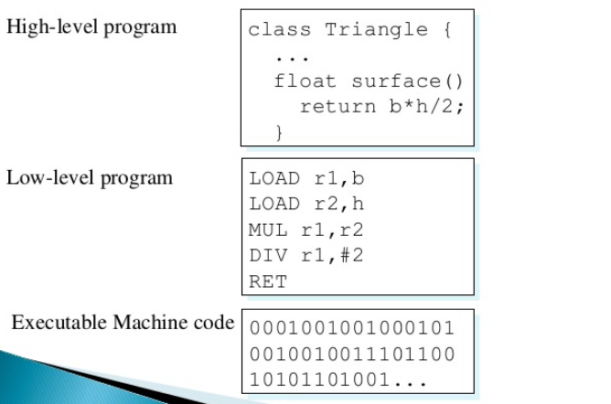
Examples

Slide 11
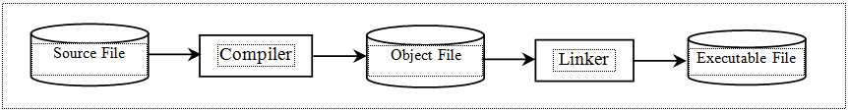
Compiling Source Code
A program written in a high-level language is called a source program (or source code). Since a computer cannot understand a source program. Program called a compiler is used to translate the source program into a machine language program called an object program. The object program is often then linked with other supporting library code before the object can be executed on the machine.

Slide 12
Interpreting
Some programs are translated using an interpreter. Such programs are translated line-by-line instead of all at once (like compiled programs). Interpreted programs generally translate quicker than compiled programs, but have a slower execution speed.

Slide 13
Types of Errors
Syntax Error: Syntax errors are mistakes such as misspelled keywords, a missing punctuation character, a missing bracket, or missing closing parenthesis. Compiler gives warning or error messages for these types of errors.
Example:
Missing ; or {} etc.
Logical Error: Logical errors are those errors that prevent your program doing what you expected it to do. Compiler don’t give warning or error messages.
Example:
Mistakenly type + instead of multiply it will execute properly but don’t give any error.

Slide 14
Algorithm
An algorithm is a step-by-step procedure to resolve any problem. An algorithm is an effective method expressed as a finite set of well-defined instructions.
Thus, a computer programmer lists down all the steps required to resolve a problem before writing the actual code.
Pseudocode: An algorithm written in human understandable language is called Pseudocode. Or Pseudocode is a detailed description of what a computer program must do, expressed in an English like language rather than in a programming language.

Slide 15
Pseudocode Example
Write a Program to Print the Sum of two integer Numbers?
Start the program
Read the first number and save in the variable ( N1 )
Read the second number and save in the variable ( N2 )
Sum the both numbers and save the result in the variable ( Sum ) -> Sum = N1 + N2
Print the variable ( Sum )
End the program

Slide 16
Question
Write the pseudocode for a program that calculates and prints the sum of the even integers from 2 to 30.

Slide 17
Solution
Pseudocode:
Start the program Create a variable to hold a counter from 2 to 30.
Initialize the counter to 2.
Create a variable to hold the sum.
Initialize the sum to zero.
Loop While the counter is less-than-or-equal to 30
add the counter to the sum
add two to the counter.
repeat until the counter reach 30
Print the sum.
End of program

Slide 18
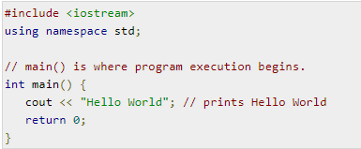
Basic Program and Libraries
The C++ language defines several headers, which contain information that is either necessary or useful to your program. For this program, the header <iostream> is needed.
The line using namespace std; tells the compiler to use the std namespace. Namespaces are a relatively recent addition to C++.
The next line '// main() is where program execution begins.' is a single-line comment available in C++. Single-line comments begin with // and stop at the end of the line.
The line int main() is the main function where program execution begins.
The next line cout << "Hello World"; causes the message "Hello World" to be displayed on the screen.
The next line return 0; terminates main( )function and causes it to return the value 0 to the calling process.

Slide 19

Compile and Execute C++ Program
Let's look at how to save the file, compile and run the program. Please follow the steps given below −
Open a text editor and add the code as above.
Save the file as: hello.cpp
Open a command prompt and go to the directory where you saved the file.
Type 'g++ hello.cpp' and press enter to compile your code. If there are no errors in your code the command prompt will take you to the next line and would generate a.out executable file.
Now, type 'a.out' to run your program.
You will be able to see ' Hello World ' printed on the window.

Slide 20
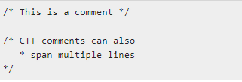
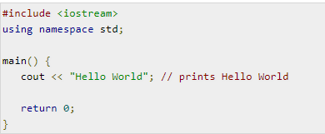
Comments in C++
Comments help anyone reading the source code. All programming languages allow for some form of comments.
C++ supports single-line and multi-line comments. All characters available inside any comment are ignored by C++ compiler.
C++ comments start with /* and end with */.
For example −
A comment can also start with //, extending to the end of the line. For example −

Slide 21
C++ Data Types
Primitive Built-in Types
typedef Declarations
Enumerated Types

Slide 22
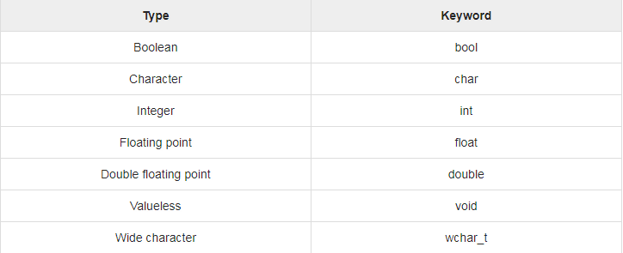
Primitive Built-in Types
Following table lists down seven basic C++ data types −
Several of the basic types can be modified using one or more of these type modifiers −
signed
unsigned
short
long

Slide 23
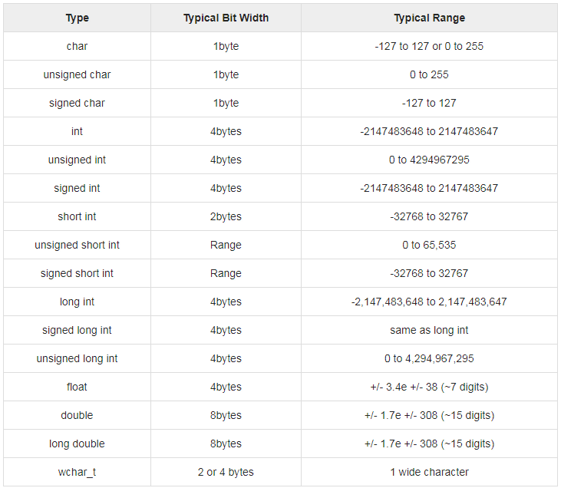
Primitive Built-in Types

Slide 24
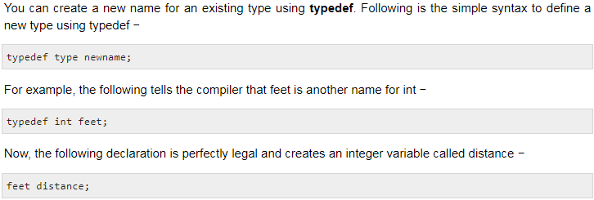
typedef Declarations

Slide 25
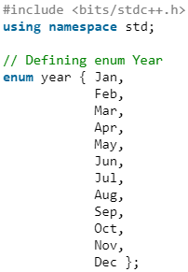
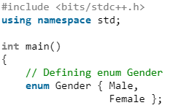
Enumerated Types
An enumerated type declares an optional type name and a set of zero or more identifiers that can be used as values of the type. Each enumerator is a constant whose type is the enumeration.
Creating an enumeration requires the use of the keyword enum. The general form of an enumeration type is −
Example:

Slide 26
Homework
Write an algorithm to withdraw, transfer, view balance from ATM machine?

